Slide 1
R PROGRAMMING

Slide 2
index
Sr.No | Title
1 | Introduction
2 | Aim of Project Intended Outcome
3 | Dataset
4 | Dataset Description
5 | Statical Analysis
6 | Data Visualisation
7 | Insights
8 | Recommendation

Slide 3
Introduction
An R programming project aims to leverage the capabilities of the R programming language for statistical computing and data analysis. This includes tasks such as data exploration, statistical modeling, data visualization, automation, report generation, package development, integration with other tools, data cleaning, preprocessing, optimization, and collaboration. The goal is to use R as a powerful tool to analyze and derive meaningful insights from data in various domains.
Intended Outcome
Data Analysis and Exploration
Statistical Modeling
Data Visualization
Report Generation

Slide 4
dataset
This dataset contains information about the salaries of employees at a company. Each row represents a different employee, and the columns include information such as age, gender, education level, job title, years of experience, and salary.
Columns:
Age: This column represents the age of each employee in years. The values in this column are numeric.
Gender: This column contains the gender of each employee, which can be either male or female. The values in this column are categorical.
Education Level: This column contains the educational level of each employee, which can be high school, bachelor's degree, master's degree, or PhD. The values in this column are categorical.
Job Title: This column contains the job title of each employee. The job titles can vary depending on the company and may include positions such as manager, analyst, engineer, or administrator. The values in this column are categorical.
Years of Experience: This column represents the number of years of work experience of each employee. The values in this column are numeric.
Salary: This column represents the annual salary of each employee in US dollars. The values in this column are numeric and can vary depending on factors such as job title, years of experience, and education level.

Slide 5
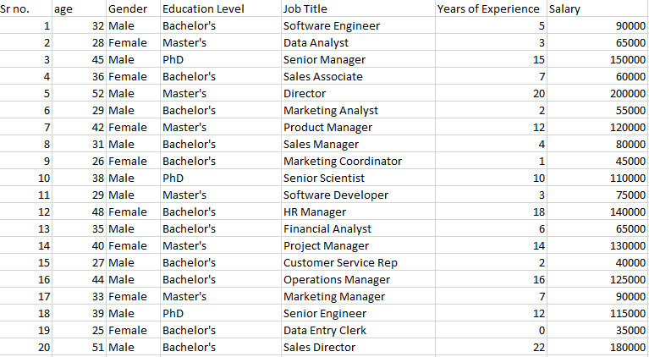

Slide 6
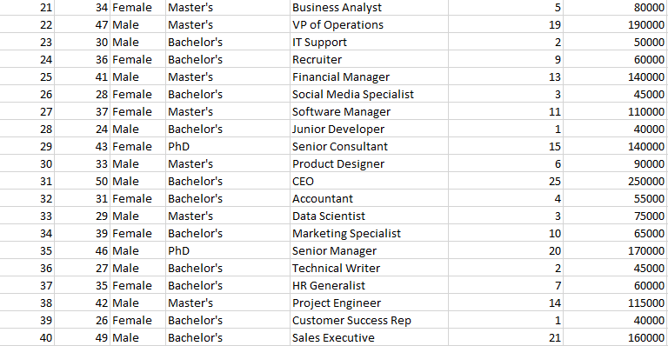

Slide 7
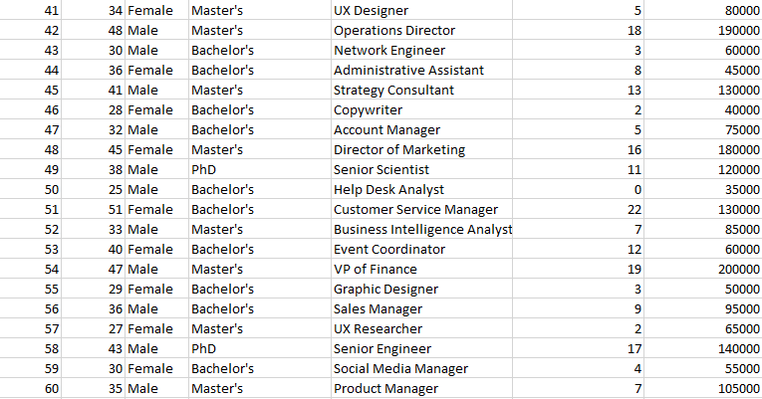

Slide 8


STATISTICAL ANALYSIS
INPUT
OUTPUT
This will print the dataset that was stored in an Excel file
INPUT

Slide 9
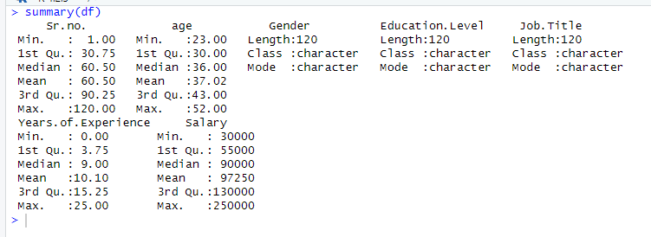
OUTPUT

Slide 10
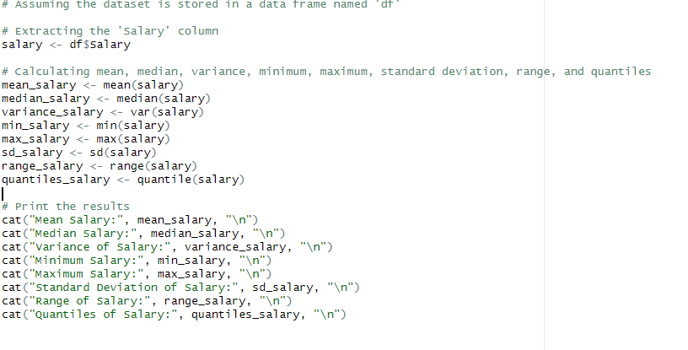
INPUT

Slide 11
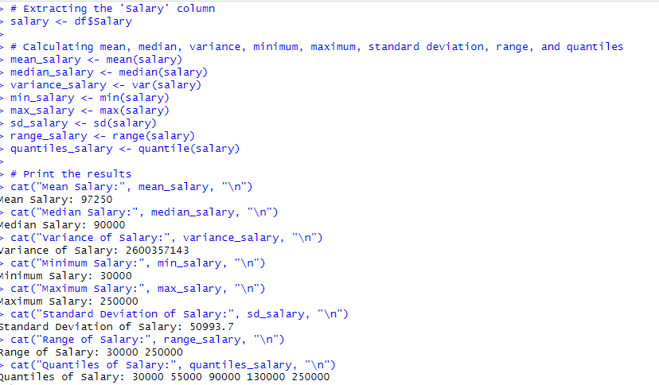
OUTPUT

Slide 12
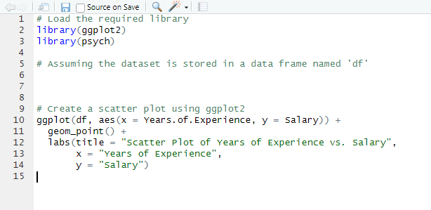
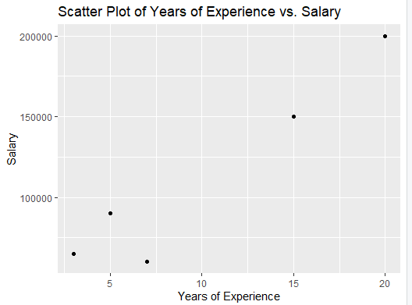
DATA VISUALISATION
INPUT OUTPUT

Slide 13
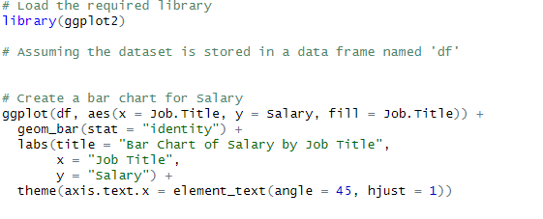
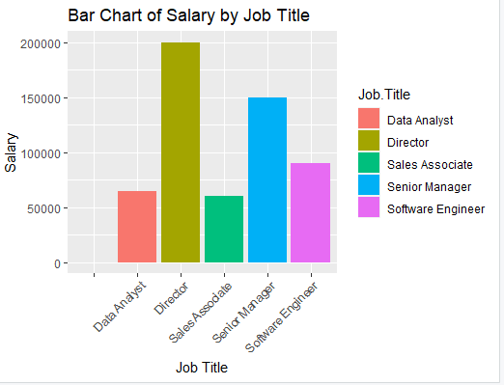
INPUT

Slide 14
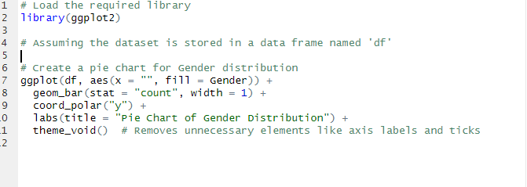
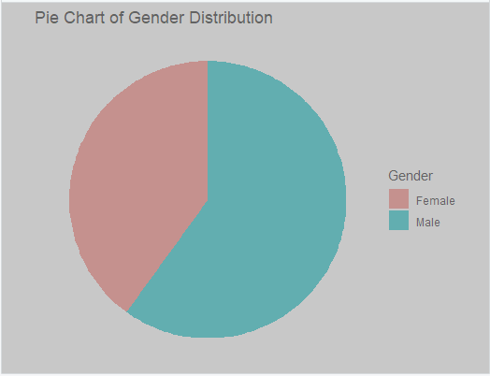
INPUT

Slide 15
INSIGHTS based on the dataset provided (featuring columns like "Age," "Gender," "Education Level," "Job Title," "Years of Experience," and "Salary"), I can suggest some general insights and visualizations that might be of interest: Age Distribution: Visualize the distribution of ages in the dataset using a histogram or a density plot. This can provide insights into the age demographics of the workforce. Gender Distribution: Create a pie chart or a bar plot to show the gender distribution in the dataset. This helps in understanding the gender balance within the sample. Education Level vs. Salary: Use a bar plot or box plot to compare the average salaries across different education levels. This can reveal if there's a correlation between education level and salary. Job Title vs. Salary: Create a bar plot or a box plot to visualize the salary distribution across different job titles. This can provide insights into the salary range for different roles.

Slide 16
RECOMMENDATIONS
Gender Pay Gap Analysis:
Conduct a detailed analysis of the gender pay gap within the organization. This may involve a more in-depth exploration of salary differences between male and female employees across different job titles and experience levels.
Employee Retention Strategies:
Explore the relationship between years of experience and job satisfaction. Identify trends or patterns that might indicate potential areas for improvement in employee retention or engagement.
Performance Analysis by Job Title:
Consider a performance analysis by job title to understand if there are variations in performance metrics or outcomes. This can help in recognizing high-performing teams or areas for improvement.

Slide 17
THANK YOU

